Slide 1

Green University of Bangladesh Department of Computer Science and Engineering(CSE)
Faculty of Sciences and Engineering Semester: (Fall , Year:2022), B.Sc. in CSE (Day)
LAB REPORT NO : 06
Course Title : Structured Programming Lab
Section : DC
Course Code : CSE 104
Student Details
Name | ID
Md. Sohan Millat Sakib | 222902036
: 01-12-2022
Lab Date Submission Date : 06-12-22 Course Teacher’s Name
: JARIN TASNIM TONVI
[For Teachers use only: Don’t Write Anything inside this box]
Marks:.....
Comments:
Lab Report Status
Signature: Date:.........

Slide 2
Problem 1:
Title: Write a C Program to print Perfect Numbers between given interval using function.
Objectives:
To be familiar with scanf and printf functions.
To be familiar with logical expression.
To be familiar with for loop.
To be familiar with user defined function.
Input & Output:
At first, the program read the range for find out all Perfect number . Then the program check all number in range are Perfect number or not. And print all Perfect Number in range.
Implementation:

Slide 3
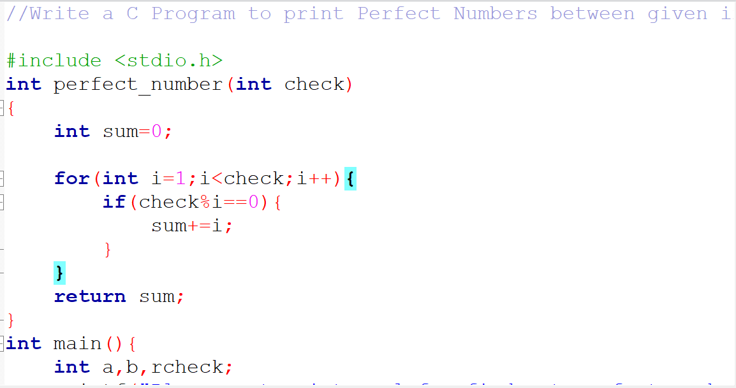
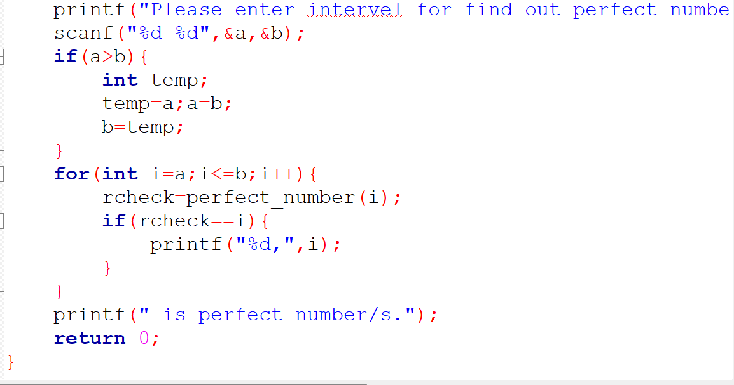
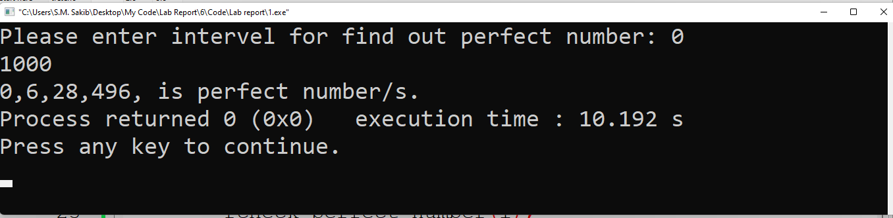
Test Result:

Slide 4
Discussion: When I write the program I have to learn about Perfect Number. Then I apply logic and write the program…
Problem 2:
Title: Write a C program to create menu driven calculator that performs basic arithmetic operations (add, subtract, multiply and divide) using functions.
Objectives:
To be familiar with scanf and printf functions.
To be familiar with if else conditions.
To be familiar with logical expression.
To be familiar user-defined function.
Input & Output:
At first, the program read a basic arithmetic expression. Then the program checks the mathematical operator and shows the result..

Slide 5
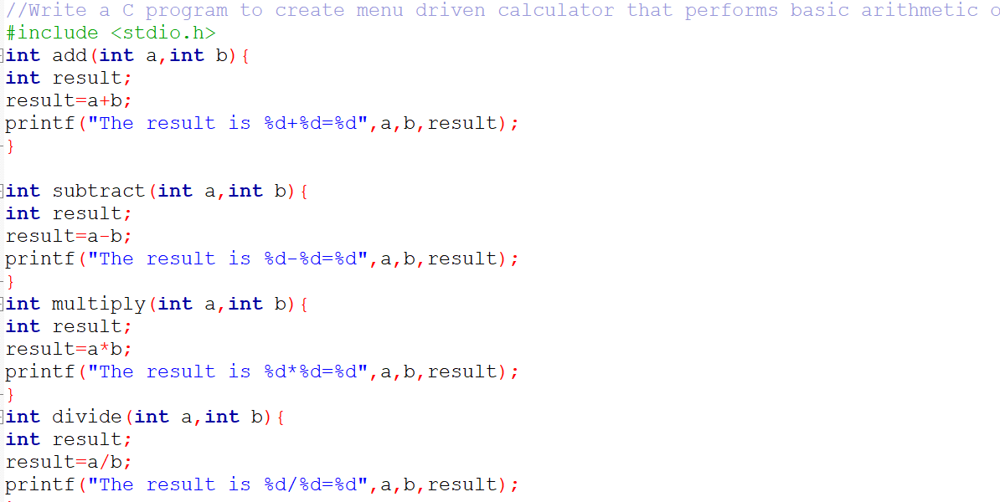
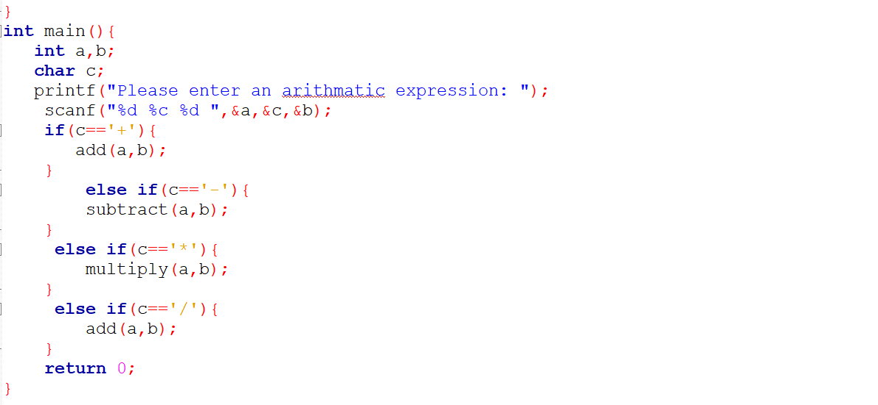
Implementation:

Slide 6
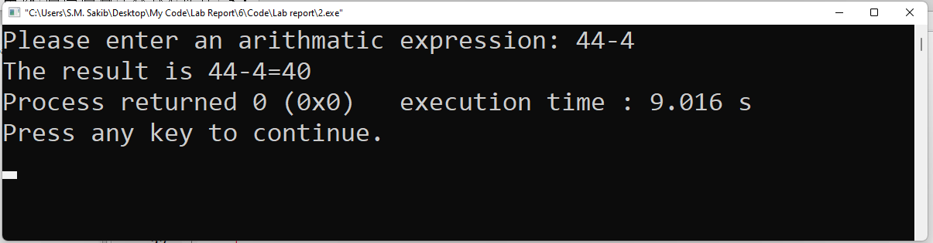
Test Result:
Discussion: When I solve the problem I don’t face any problem….
Problem 3:
Title: Write a C Program to print Strong Numbers between given interval using function.
Objectives:
To be familiar with scanf and printf function.
To be familiar with for loop.
To be familiar with if else condition.
To be familiar with user defined function.

Slide 7
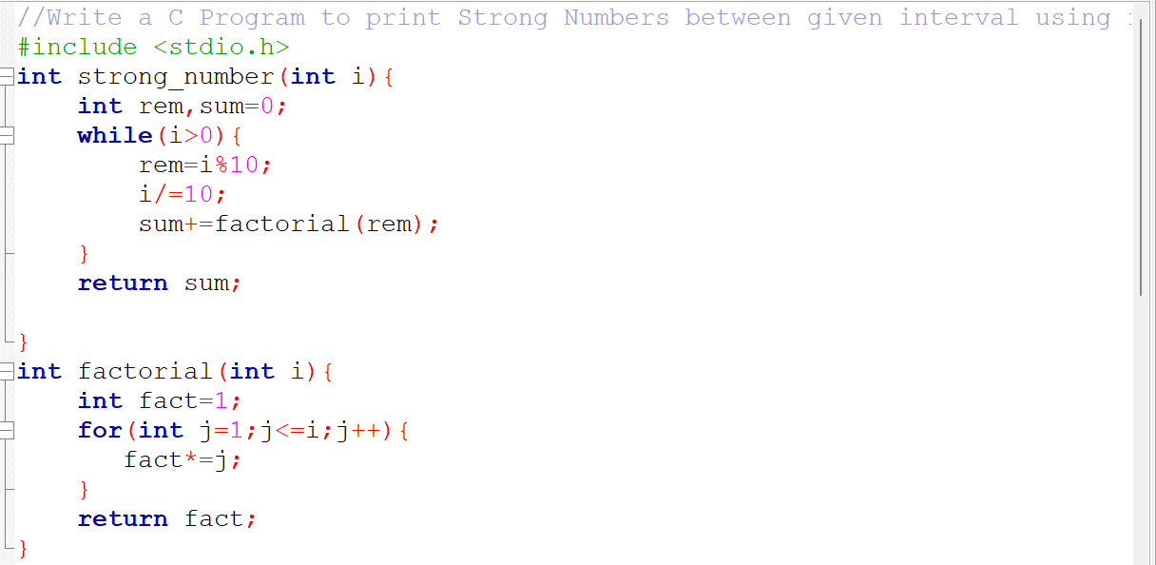
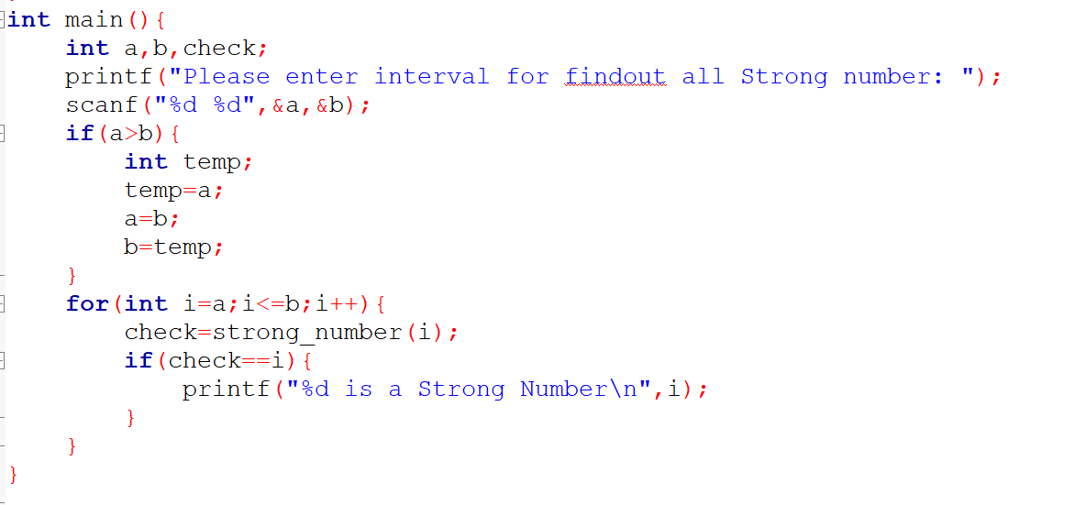
Input & Output:
This program are input the the interval for find out the range of strong number. Then appling some mathmethical logic the program find out the number is strong number or not.
Implementation:

Slide 8
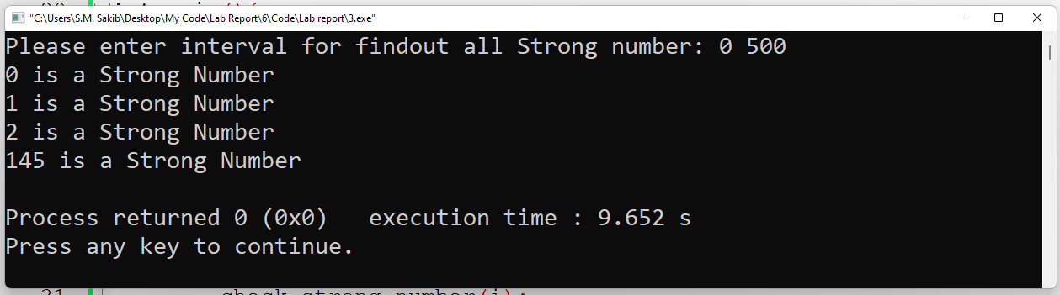
Test result:
Discussion: When I solve this programme I have to learn about strong number then I apply logic and solve this problem.

